Slide 1

Overview of Energy efficiency sector
Cynthia Alexander
Principal Officer for Renewable Energy and Energy Management
Seychelles Energy Commission

Slide 2

Outline of the presentation
IOC - Energies
Energy Policy/Energy Act
Energy Mapping
GOS-UNDP-GEF RE Project
Incentives & Plans

Slide 3



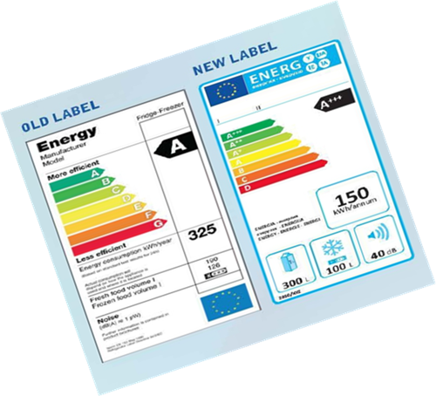
IOC Energies Program
A Regional approach to address challenges faced by the IOC countries to reduce their dependence on importation of fossil fuel and to create an enabling environment for more RE technologies and EE measures.
5 year program ending in June 2019
15 Million Euros for five Islands
Introduce a regional strategy
Improvement of capacity (public/private)
Standards and Labels for Buildings and Electrical appliances
Improved regulatory environment
Notes:
Talk about PREE

Slide 4


Energy Policy & Energy Act
Energy Policy
To Develop a Sustainable Energy sector
Target for Renewable Energy:
5 % RE by 2020
15% RE by 2030
Recommendations for Energy Efficiency
National Action Plan on Energy Efficiency
Establishment of MEPS for electrical appliances with adoption of international standards and labeling
Tropical Building code
Energy Act
Enactment of the Energy Act 2012. Operational in 2013
Formal establishment of Seychelles Energy Commission (SEC) whose role is to regulate the electricity sector.
The Energy Act provides clear guidelines for the regulation of the electricity sector and the promotion of renewable energy and energy efficiency

Slide 5
Energy Mapping study
SEC and AFD in assessing the EE market in the large consumer in Seychelles
Study conducted by the Technical Assistance for the implementation of Sunref and PNEE implementation (June to October 2015) Supported by SEC, Financed by EU and AFD
Private sectors: industry and large buildings including tourism, commercial areas and supermarkets, offices. Extended to some “parastatal” companies
Technical fields: all kinds of actions leading to an improvement of the energy efficiency: reduction of energy consumed for the same service or same level of production
Commercial Consumers (PUC) | Number of meters | Consumed kWh/year
Total | 3 732 | 195 000 000
Large consumers: over 200 000 kWh /year | 111 | 141 500 000
% of large consumers | 3% | 73%

Slide 6
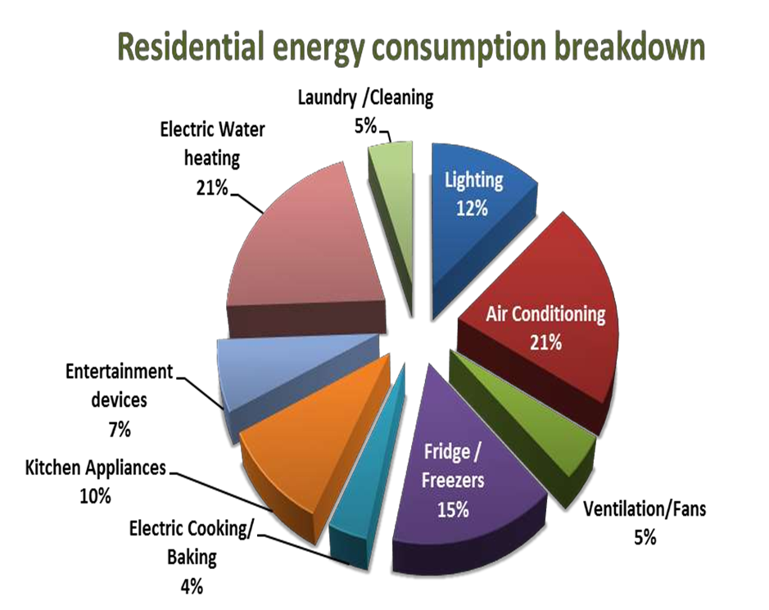
GOS-UNDP-GEF RE Project
Create the appropriate environment to transform and strengthen the market of Resource Efficient Technologies.
1.7 M USD 4 year project started in 2014
Improved policy, institutional, legal/regulatory and financial framework for resource efficient technologies
Awareness-raising and educational campaign on RE technologies
Training schemes to support market for RE technologies
Financing Mechanisms to support adoption of RE technologies.
Energy Baseline Studies
Household Monitoring exercise
Minimum Energy Performance standards
Solar Water Heater Endorsement Initiative
Training with SIT

Slide 7


EEPPS
Main Objective
Implementation of Energy Efficiency measures In the public sector
Identify the potential for EE measures in the government sector
Identify innovative ways to encourage the government to become more energy efficient
Identify and addressing the gap in the available service and their providers

Slide 8
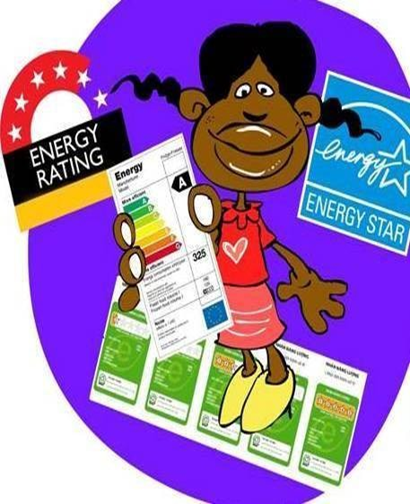
Incentives & Plans
Seychelles Energy Efficiency and Renewable Energy Program, SEEREP.
Low interest loan through commercial bank
Eligible to only domestic consumers for the adoption of RE and EE
Max. SCR150,000 with nil/2.5 % contribution at 5% interest
SMEs Loan Scheme
Low loan scheme for small and medium enterprises to adopt RE and EE
Max. SCR 6 million
Fiscal incentives
zero VAT RE/EE technologies. SEC provides the endorsement
Proposed Plans with IOC Energies
Development of tropical building code
Testing facility for Refrigerators
TVCs for Education/Awareness
Demo project of Solar PV at La Digue

Slide 9


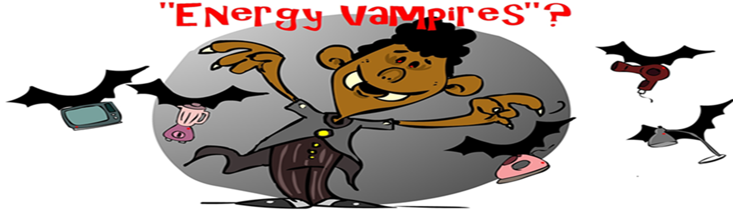
THANK YOU

