Slide 1
Model Eco-Village Riviere Coco,
Rodrigues
(Project 124)

Slide 2
Background:
The vision of Rodrigues Regional Assembly (RRA) is to make Rodrigues an ‘Ecological Island’
Energy: target - 100 % Renewable Energy by 2030. Strategy developed and Roadmap – Action Plan
Actual: Wind Energy production – 10 %
Solar Energy – (2013 stats – 0.02 GW)

Slide 3
The vision for energy policy is captured into the Regional Government Budget Speech for the year 2018/19 as follows: ‘Un plan strategigue pour l’utisation optimal de l’energie renouvelable sera prepare’.
Actions initiated by the government to align with this important vision:
Setting up of the solar water scheme.(MUR 1 m in recurrent budget)
Setting up of a model eco village project at Riviere Coco to promote the use of renewable energy with financial support from the European Union

Slide 4
Energy production from biomass through the utilisation of Accacia nilotica (pikan loulou) plants.
Production of household biogas (EU co-funded project).
Operation of desalination plant from solar energy financed by the European Union.

Slide 5
Background on Eco Village Project at Riviere Coco.
Ministry for Environment – 9 eco-villages; 2009 budgetary measure.
Consultations with stakeholders and villages.
Commission for Environment – (Commissioner Payendee) – Considered at Regional level
Committee with all relevant sectors:
Health
Sport
Environment
Energy
Fishing
Agriculture
Eco tourism
Survey on-going for data in the different sectors for more efficient policies

Slide 6
Project Objectives:
The Model Eco-village demonstration project using renewable energy sources for production of electricity and cooking purposes;
Target group: Households in Riviere Coco
Final beneficiaries: Population of Riviere Coco (1200 people) and ultimately the whole population of Rodrigues

Slide 7
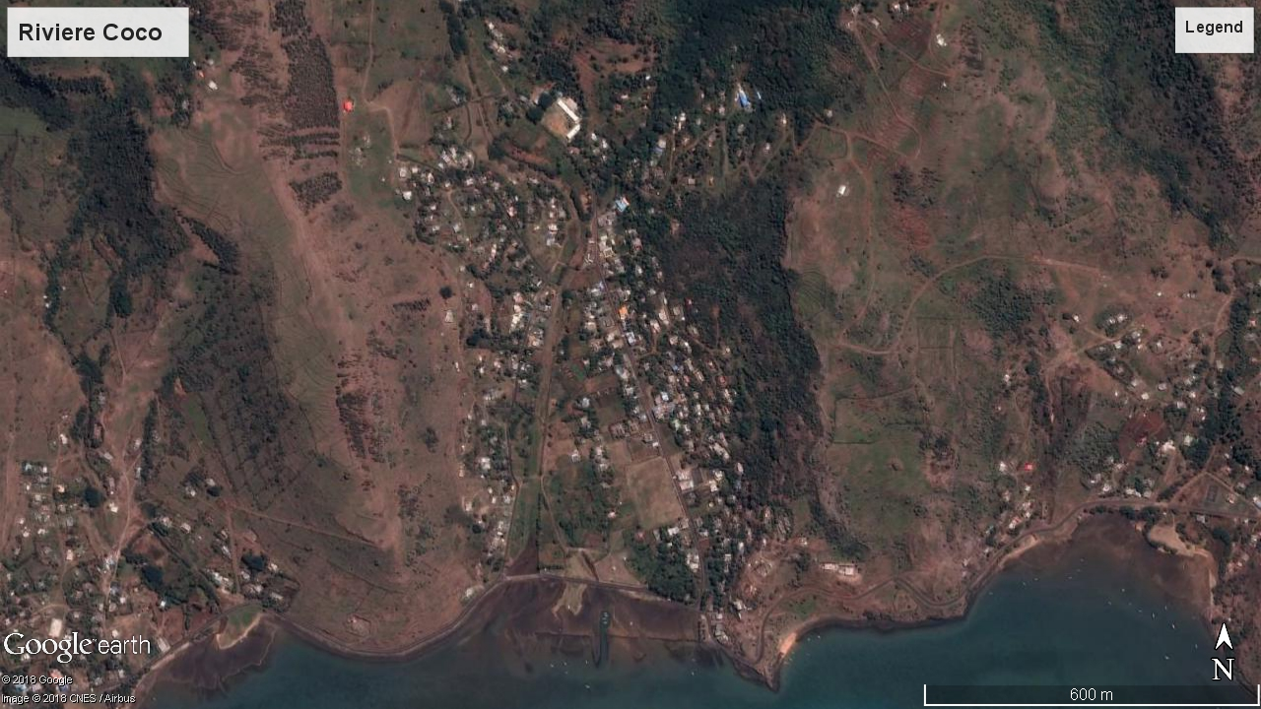

Slide 8
Project’s Activities:
Installation of Grid-connected solar systems of 1-3 KW at households. Solar charging station and electric car.
Installation of 3 biogas digesters for cooking purposes.
Installations of solar street lightings
Establishment of green roof gardens for water conservation, natural cooling and crop production.

Slide 9
PROJECT MANAGEMENT STRUCTURE
Project Implementation Committee - PIC (chaired by Commissioner)
Project Management Committees (3)- PMC
(chaired by Project Coordinator)
Solar P.V (households/ charging stations, street lightings &
Electric vehicles)
CEB/Village Committee/Village Representative – Electrician/COM P.I/RCSS
Green Roofing (COM P.I, Village Committee/ Village Representative / Water Resources Unit/COM AGRI
Biodigesters (Agriculture /Village Committee/
Farmers’ Association, COM P.I)

Slide 10
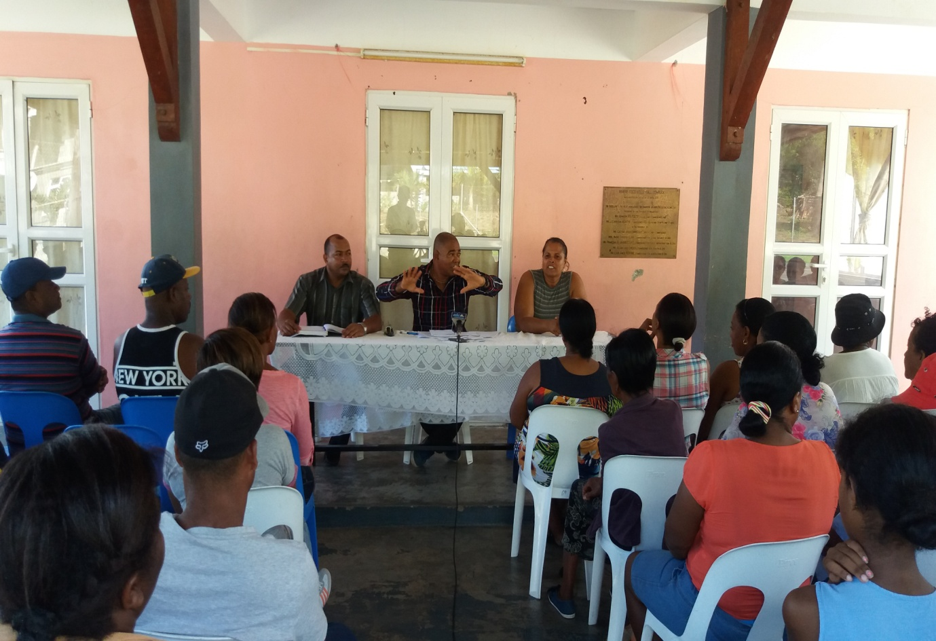
Project launched by Commissioner for Environment, Village President and Project Coordinator in end of January 2018 at the village of Riviere Coco.

Slide 11
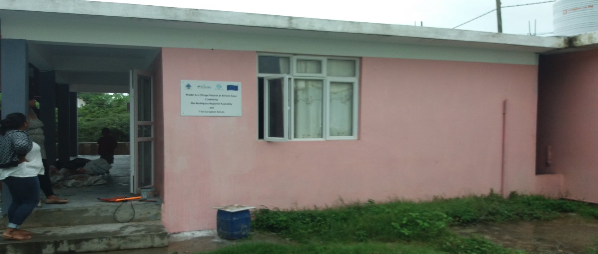
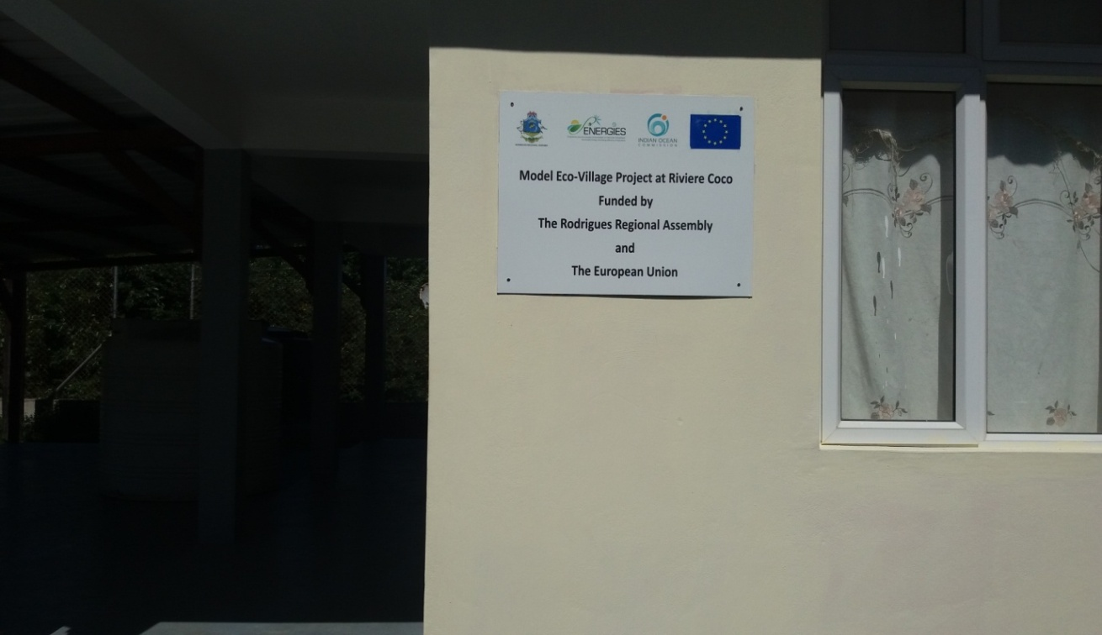
Eco village office at
Riviere Coco

Slide 12
Photovoltaic Installations, Street lightings, solar charging stations and Electric Vehicle
Project Management Committee (PMC)
Site visits and meetings
CEB as member of PMC
Village committee final decisions on sites for installation of solar street lightings
Specifications finalized by PMC
Tender under evaluation
By end of November - installation of street lightings and solar charging stations

Slide 13
Electric Vehicle
Tender launched – restricted bidding process for electric vehicle (demonstration purpose) no response
Open bidding – market survey, available in Mauritius

Slide 14
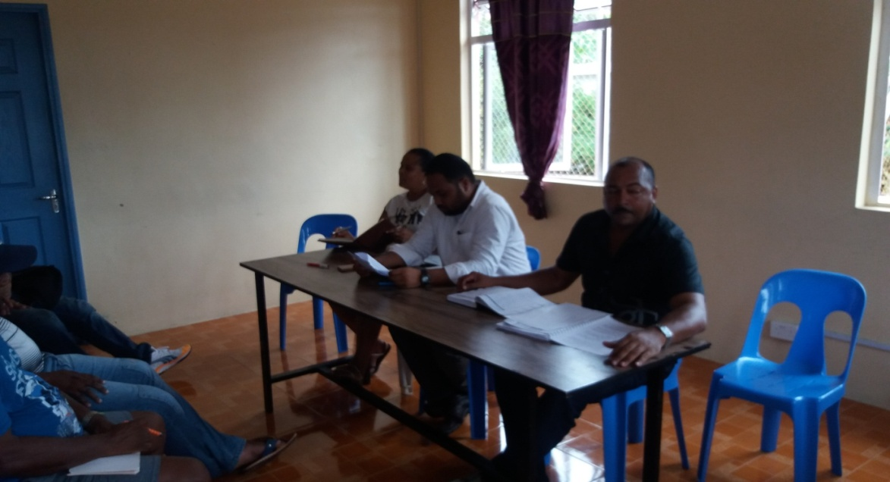
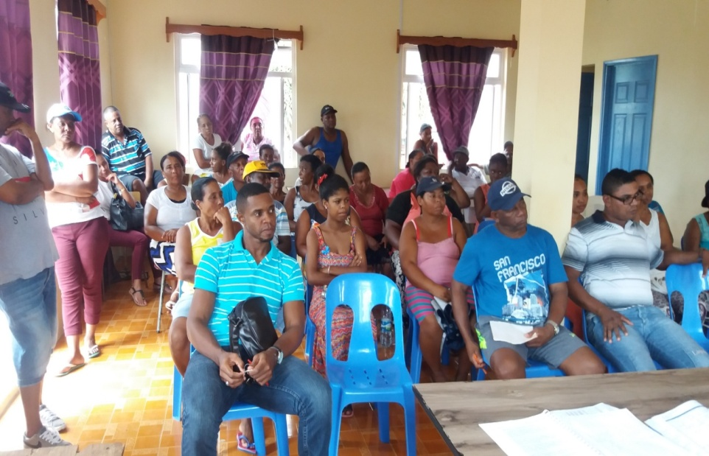
PV installations
Grid –connected
Explanation by the CEB about the 2015 SSDG Net metering scheme, procedures thereto.
66 potential beneficiaries
Awaiting approval for DBM to grant green loan of 100 % (actual scheme is 75 %)
Exercise to select suppliers to facilitate the process.

Slide 15
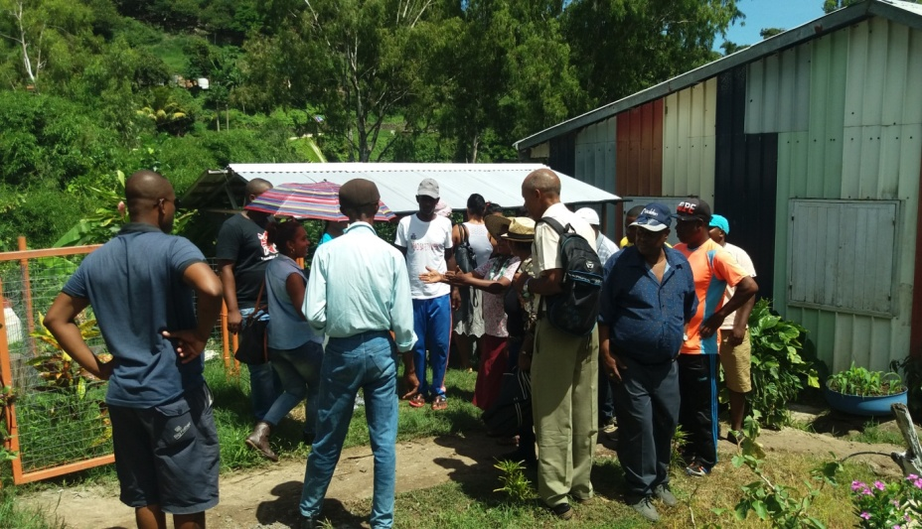
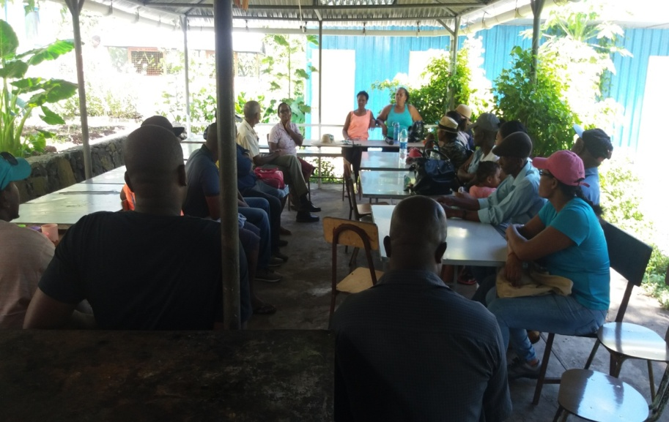
Biogas Production
Site visit at Centre Frere Remi whereby one biogas digester is operational
Setting up of Bio digesters.
3 groups of farmers – 3 types (cattle/sheep..goat/pigs)
All the beneficiaries group into one Association (Land surveyed by Com Agriculture and approval of executive council will be sought for official granting of land thereto.
Pastures and pen under constructions

Slide 16
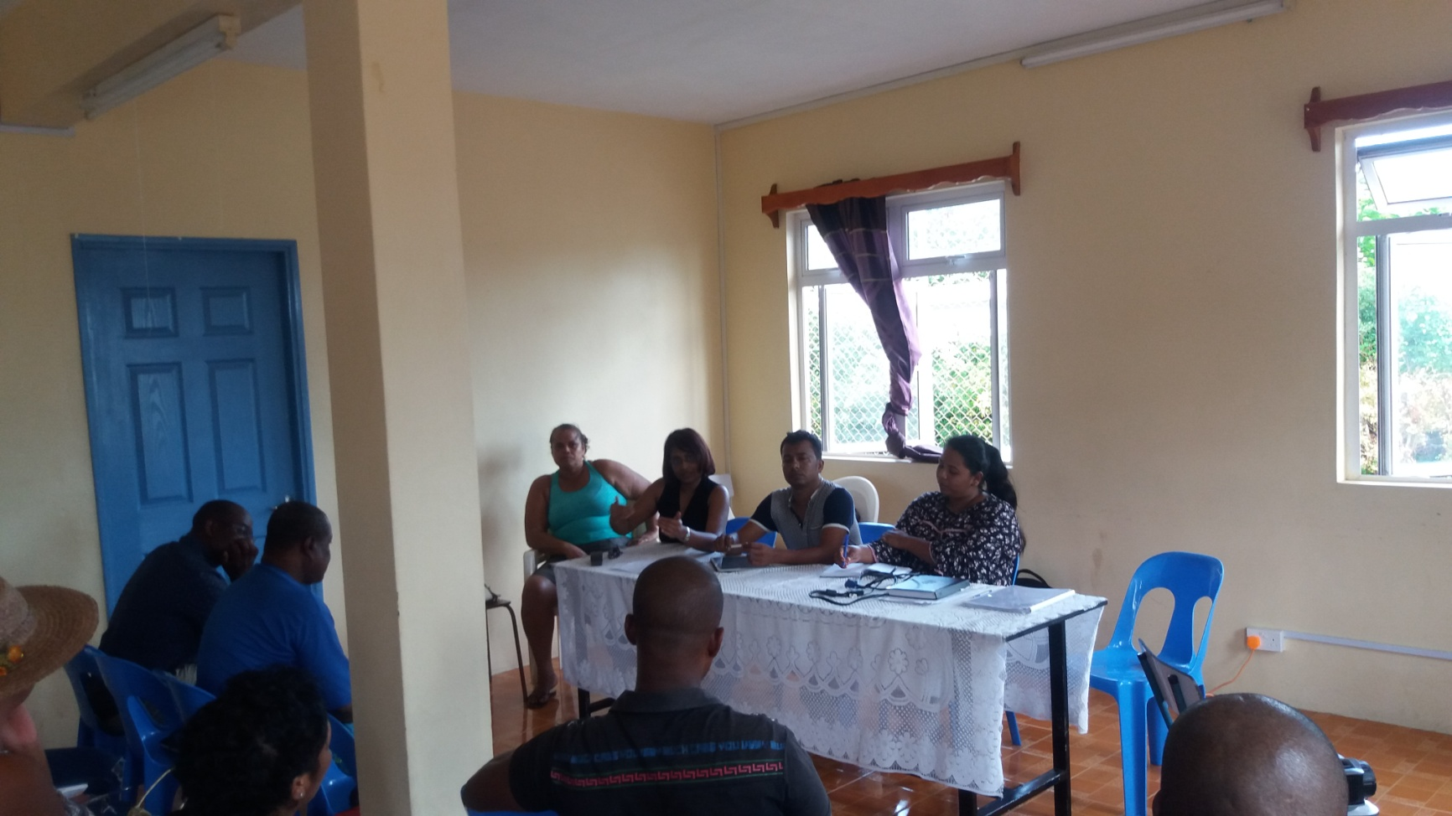
Biogas Production
First mission by University of Mauritius Team headed by Senior lecturer, Dr. SOMAROO –
explanation on the biogas production..(participation of beneficiaries/ technical aspects of the activity..
Field work for site selection for bio digesters
Meeting the local stakeholders – Engineer, Officers from Agriculture…

Slide 17
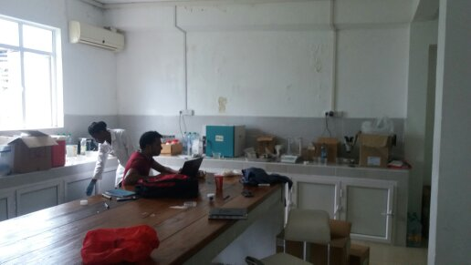
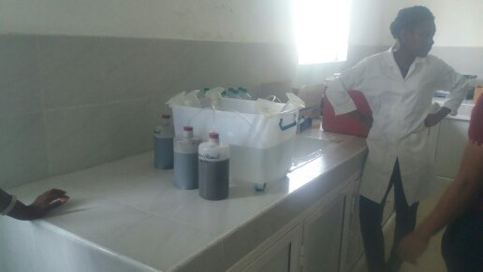
Biogas production
Fermentation test at the Commission for Agriculture Lab by University of Mauritius – 2nd mission
Implementation based on facts not assumptions agreement - data will be used for other projects in Rodrigues.
Benchmark for future work on biogas production.
Design of bio digester – end of October
Construction of bio digesters – By end of November
Construction of individual bio-digester unit (small – showcase ..fundings)

Slide 18
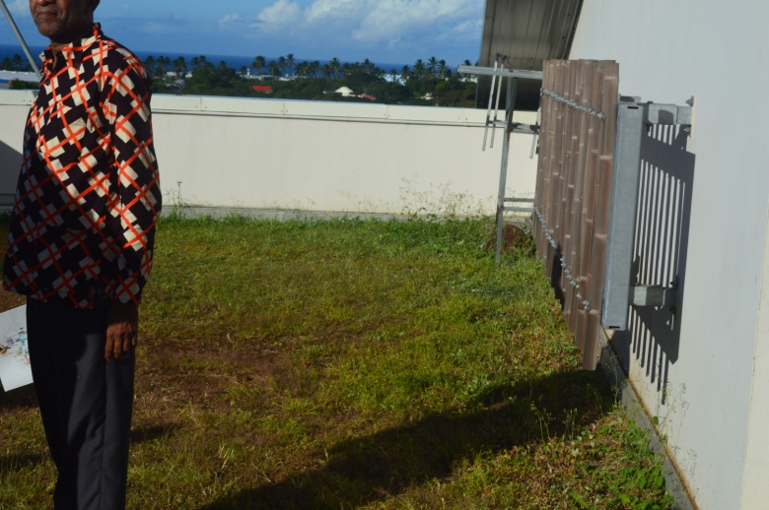
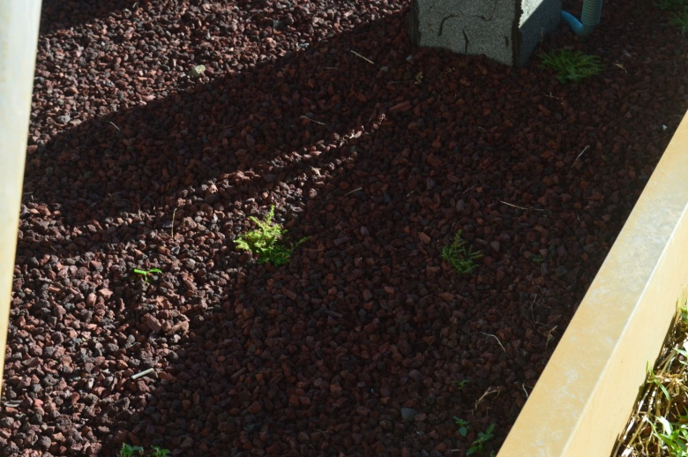
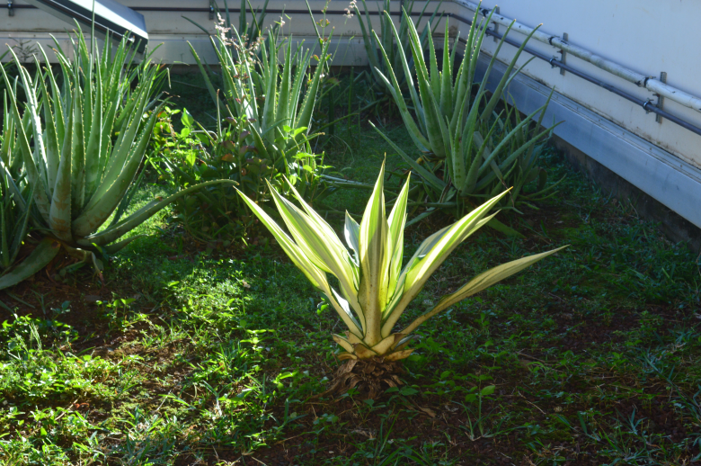
Green roofing
Mission – Reunion Island
Expertise not available at National level..No success stories
Demonstration to be effected at a primary school
Request for an expert under the IOC-Energies Program

Slide 19
Projection
Funding Commitments
By end of October 2018-
Award of contracts for procurement of Solar charging stations, Electric Vehicle, E-bike, Solar street lightings.
Estimated budget : EUR 150,000
Pasture and pen construction including payment effected for technical assistance from University of Mauritius : EUR 10,000

Slide 20
Bottlenecks and Measures:
Project Delay and Recruitment of Project Manager
Administrative issues after signing of project contract agreement and launching – Assignment as Project Coordinator and full time Officer at the Eco village Office. Commission for Environment officially informed IOC of implementation delay.
RRA long procedures for recruitment. Role of the Public Service Commission (PSC)
Addendum for consideration of new funding commitment.
Green roofing
Technical Expertise & IOC collaboration
Procurement
-Long process for finalising bid documents / launching of bids/ Evaluation
Interim Report
First period missed due to delay in project implementation - instead first report covering first 12 months being submitted.

Slide 21
THANK YOU
J.Henri FELICITE
Head Environment /
Project Coordinator – Model Eco-Village Project (Grant 126)

