Slide 1

PRODUCTION OF ENERGY FROM HOUSEHOLD ORGANIC WASTE FOR COOKING PURPOSES
GRANT 126 RODRIGUES

Slide 2
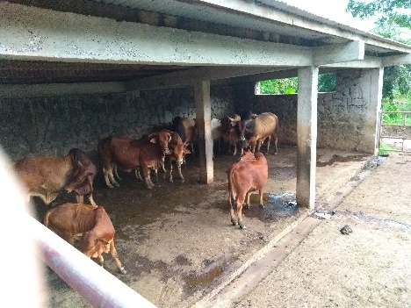
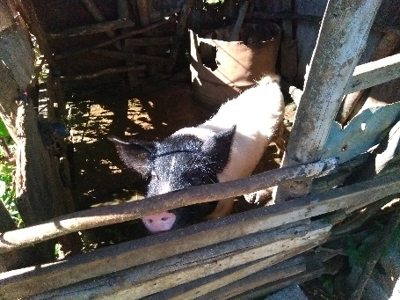
Aims and Objectives
Improve access to cooking energy
Improve sanitation of disadvantaged people
Build capacity among local trades persons
Sensitize people of Rodrigues about the production and utilization of biogas from
their own biogas wastes.

Slide 3
ACTIVITIES COMPLETED
Recruitment of Project Assistant
Setting up of a Coordination Committee
Household survey in 6 villages
Procurement process for biogas trainer
Sensitisation of stakeholders
Recruitment of trainees (including training for trainer)
Sourcing and procurement of materials for training

Slide 4
Remaining Activities
Training of trainers and trades persons (15 Oct 2018)
Contract for bio digester construction (Dec 2018 to May 2019)
Evaluation visits to all digesters and setting up a programme for sustainability (June to August 2019)
Final reporting ( September to October 2019)
Remarks: There was a slight delay in start of implementation but the project is running in time.

Slide 5
Changes to implementation
Beneficiaries must possess at least 3 pigs or cows (initial beneficiaries no longer eligible, only 56 eligible)
New villages (10 or more) to be included in the project
The Rodrigues Regional Assembly will implement an additional project for sanitation for the ineligible households
The technology will be showcased at the two breeding centers of the Commission for Agriculture
Two prison officers will benefit from the Training for Trainers

Slide 6
Thank you

